Slide 1

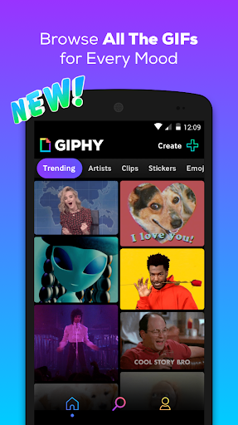
Gipher App
Wipro Velocity Batch-75
Team A: -
-DEEPA VERMA
-HARIOM MODOKAR
-KUNAL KUMAR JAISWAL
-PUSHP JAIN
-SHAIK ABDUL HAREEF
Mentor : FARHA TABASSUM

Slide 2

Outline
Problem Statement
Objective
Microservices
Project Overview
Architecture
Project Flow
Technology and Tools Used
Conclusion

Slide 3

Problem Statement
X is bored with texting and he wants to continue his texting by using GIFs. He requires an app in which all categories of GIFs are available to choose and add them into the wishlist.

Slide 4

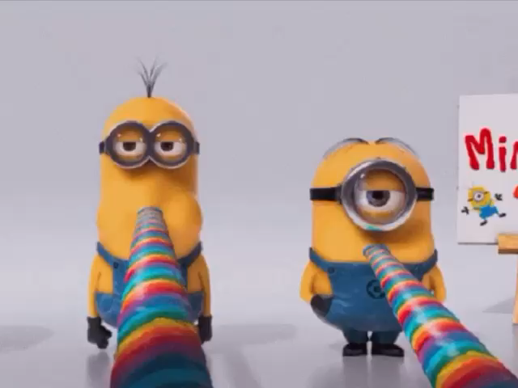
Objective
Our objective is to provide best user experience to X. So that X can get correct online search for GIF images and add them to wish list without any difficulties.

Slide 5
Microservices
Authentication Service
Wishlist Service
API Gateway

Slide 6
Project Overview

Slide 7
Project Overview
Authentication Service
Wishlist Service
Favourite
Login
Home
GIF Details
Search GIF
Register
SQL
Server
Mongo
Db
External API

Slide 8
Onboarding Architecture

Slide 9

Architecture
Authentication Service
MySQL
SPA
API Gateway
Eureka Server
External API service
Wishlist Service
MongoDB

Slide 10
Project Flow

Slide 11

Project Flow
Login
Registration
Home
Profile
Favourite
Search
Categories
View Favourite
Delete Favourite
Animal
Nature
Sports
Cars

Slide 12






Technologies and Tools Used

Slide 13
Conclusion
The Gipher app helps the user to search for gif images and add them to wish list. It helps user to search GIF’s of their wish. It also helps user to add their favorite GIF’s so that they can access it in future and delete them afterwards.

Slide 14
Thank You

Slide 15


